Slide 1
MKTG 571:
Logistic Regression
Assignment Results

Slide 2
Results from Assignment

Slide 3
Logistic Regression for Targeted Mailing at BookBinders
Dependent Variable:
  Purchase “Art History of Florence” (1=yes, 0=no)
Predictor Variables:
  # months since last purchase (last) - Recency
  Total dollars spent to date (Total$) - Monetary
  Gender
  # children’s books purchased (child)
  # youth books purchased (youth)
  # cookbooks purchased (cook)
  # do-it-yourself books purchased (do_it)
  # reference books purchased (reference)
  # art books purchased (art)
  # geography books purchased (geog)
Frequency
(by category)

Slide 4
How “Good” is the Model?
Overall significance: check the ‘sig.’ of the final model
Nagelkerke’s R² is similar to the familiar R² in linear regression – but ‘R²’s in logistic regression tend to be lower
The 2x2 classification table summarizes observed and predicted values:
Predicted
0
1
0
Right
Wrong
Observed
% correct
1
Wrong
Right

Slide 5
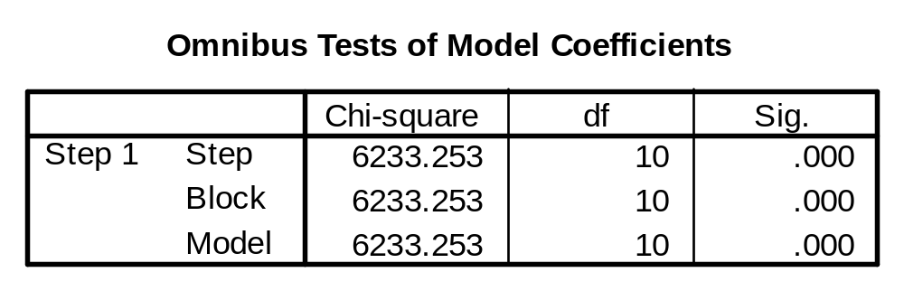
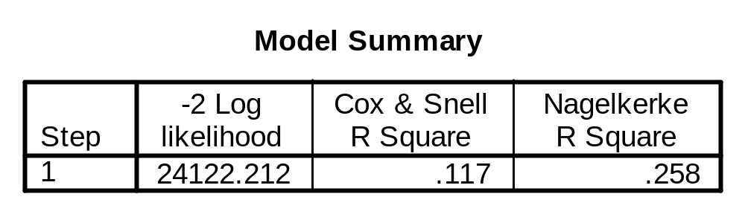
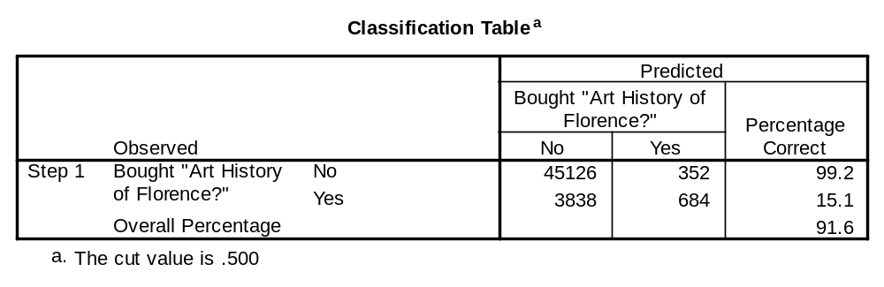

Slide 6
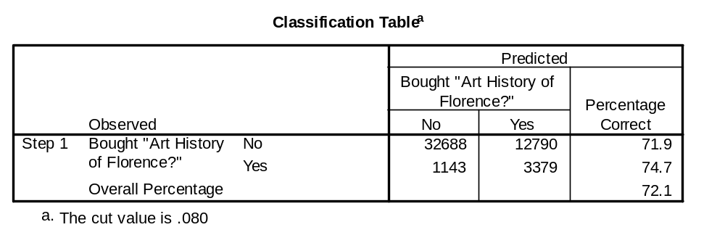
Changing the Cut Value
This does not change the coefficients, tests of significance, etc.

Slide 7
Compare the Implications
Cost of Errors
Default cutoff of .50
  Percent correct = 91.6%
  Cost: 3838(5.50) + 352(.50) = $21,285
Cutoff = .08
  Percent correct = 72.1%
  Cost: 1143(5.50) + 12709 (.50) = $12,681.5
Would you rather be right or rich?
$0
$0.50
$5.50
$0

Slide 8
Interpretation of Results
Which variables are statistically significant?
Which variables seem to be ‘important’?
What do the coefficients mean?

Slide 9
Interpretation of Results
Which variables are statistically significant?
  Look at the p-values (“sig.”) for each variable
Which have a positive effect and which a negative effect?
The odds ratio is a multiplicative coefficient
  indicates how the odds that Y=1 will change if X increases by 1
  ‘positive’ effects are greater than one
  ‘negative’ effects are between zero and one
  coefficients close to 0 will have odds ratios near 1

Slide 10
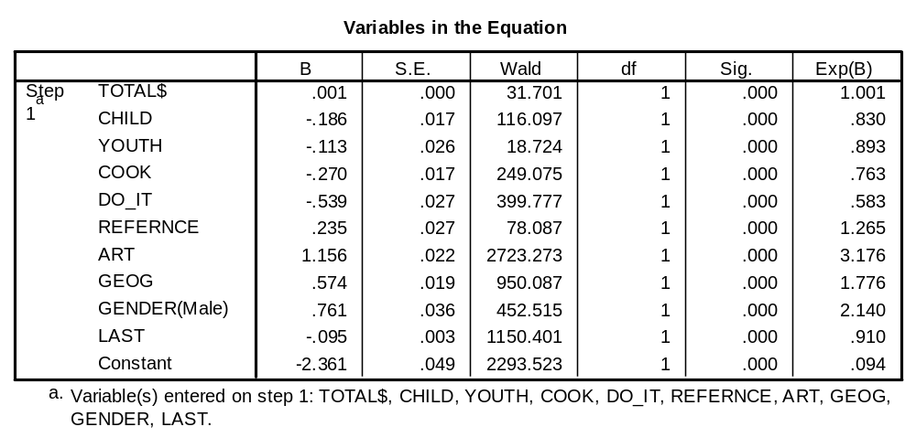
Logistic Regression Coefficients

Slide 11
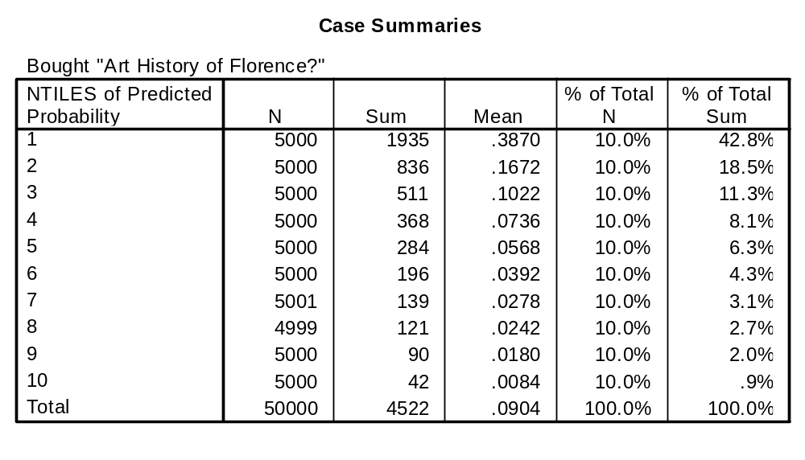
Predicted Probability of Purchase
Buyers
Response Rate
% of Total Buyers

Slide 12
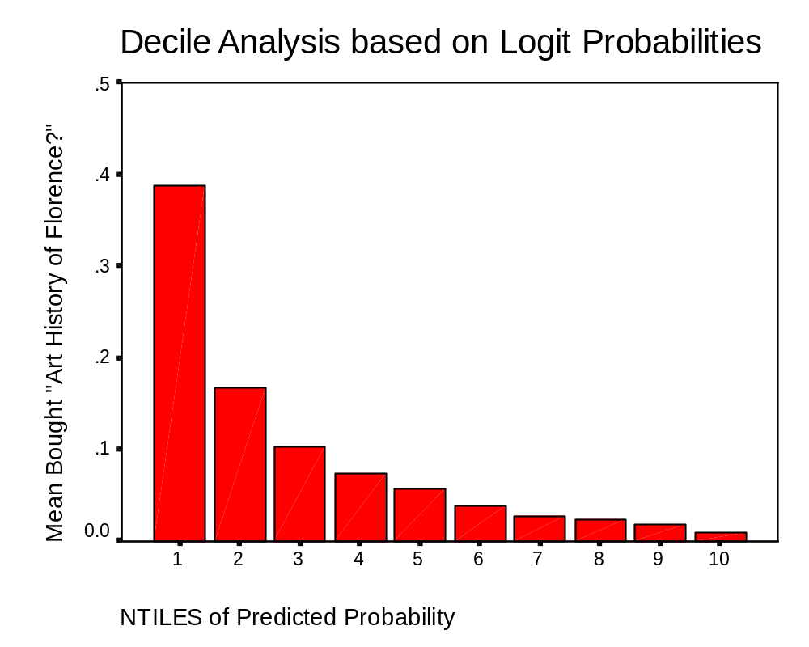
Response Rate by Deciles
Predicted Probability Deciles

Slide 13
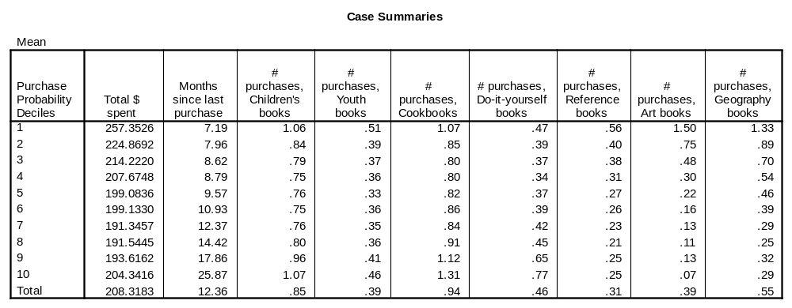
Decile Analysis on Key Variables

Slide 14
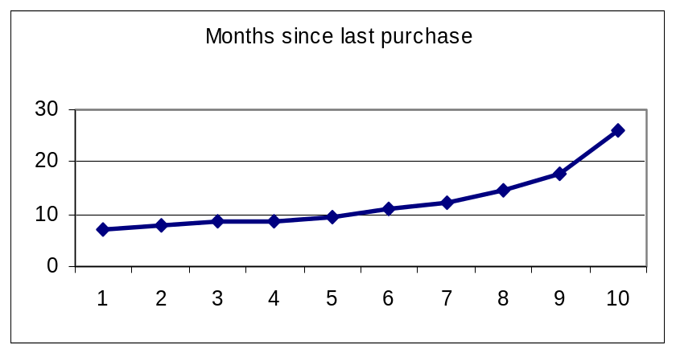
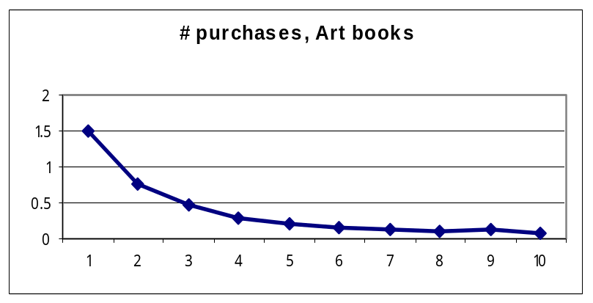
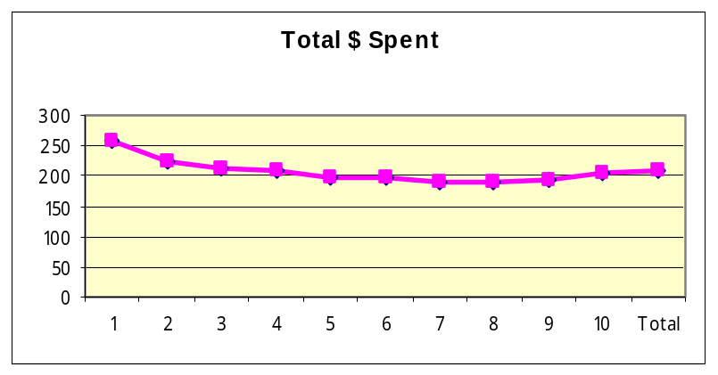
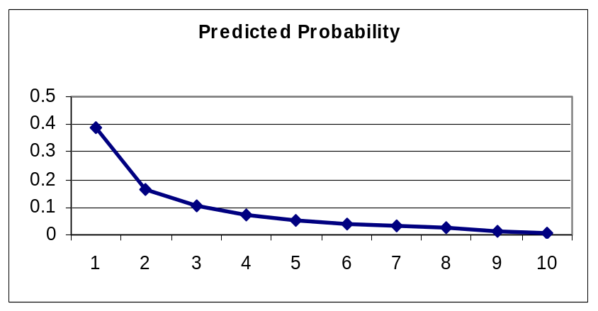
Decile Analysis - Graphed

Slide 15
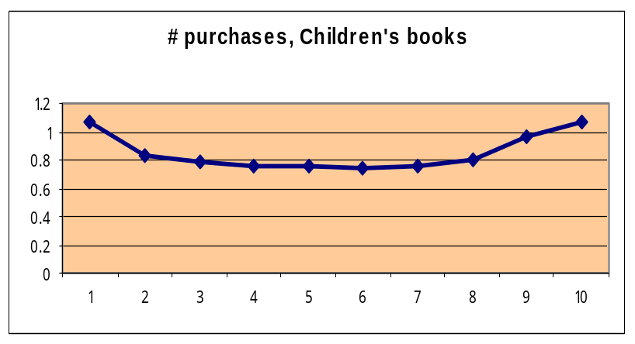
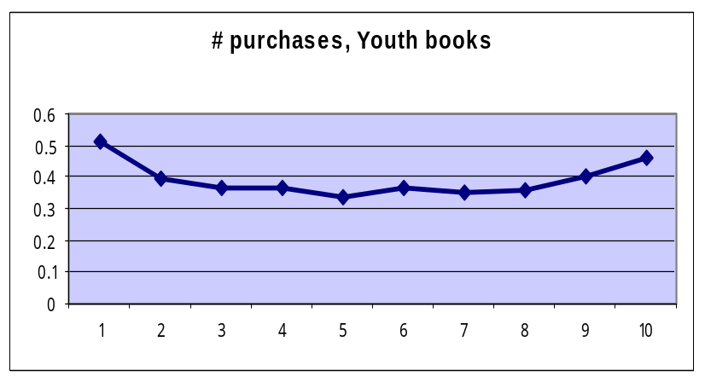
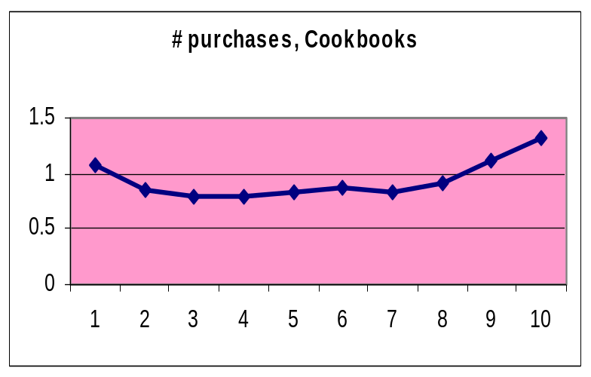
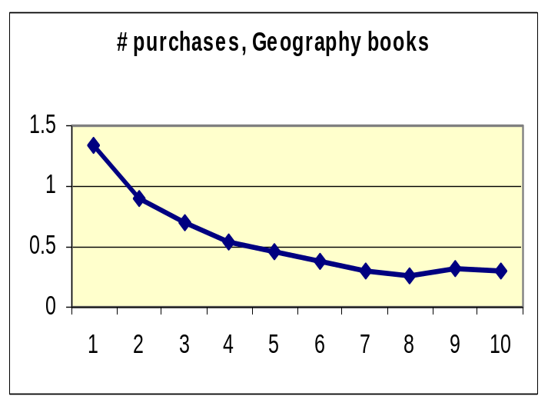
Graphs (Cont.)

Slide 16
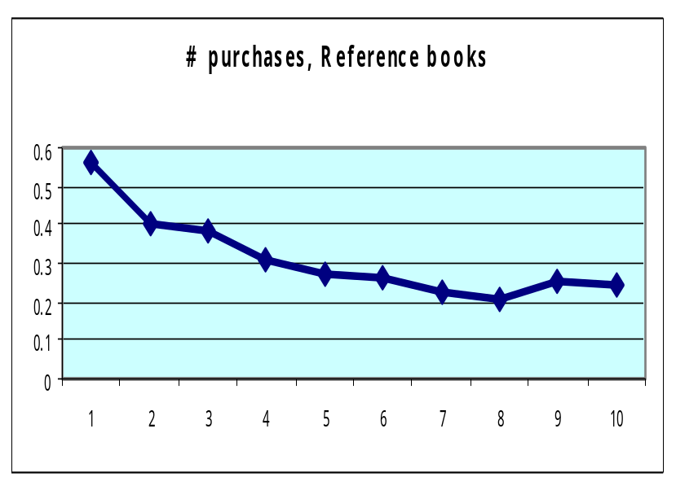
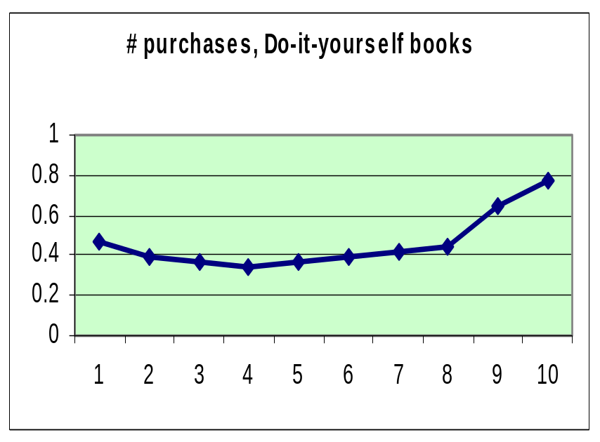
And more …

Slide 17
Assessing Model Performance
Lift
  (response rate for that decile/overall response rate) * 100
Cumulative Lift
  (cumulative response rate up through that decile/overall response rate) * 100
Gains
  Proportion of buyers/responders in that decile/group
Cumulative Gains
  Sum of gains up to and including that decile/group

Slide 18
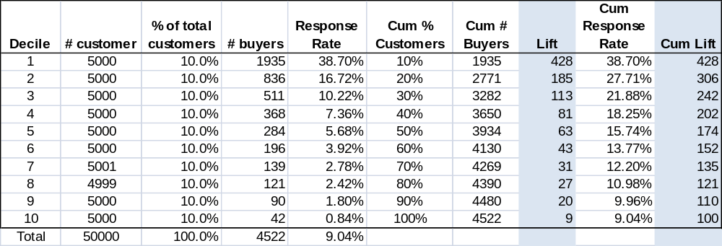
Lift Table
Lifts greater than 100 indicate that the group (decile in this case) has an above average response rate. Lifts less than 100 indicate a below average response rate.

Slide 19
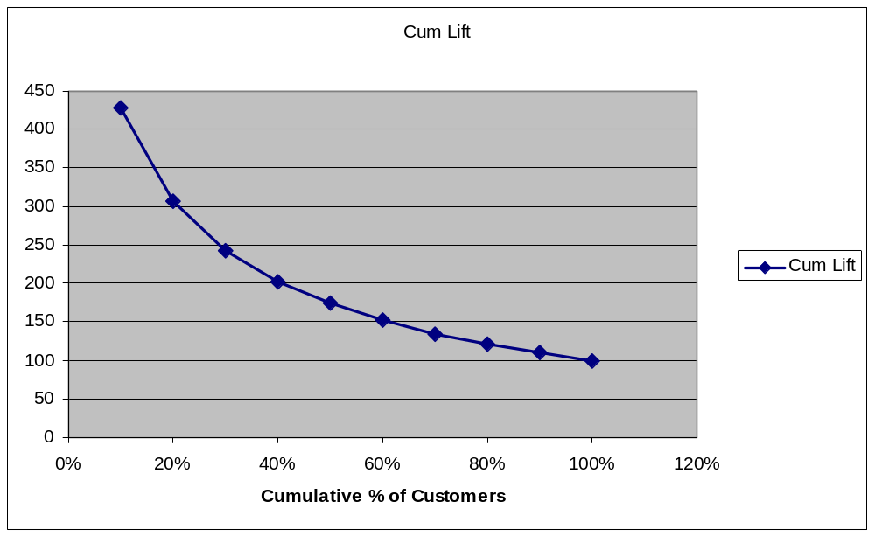
Cumulative Lift Graph

Slide 20
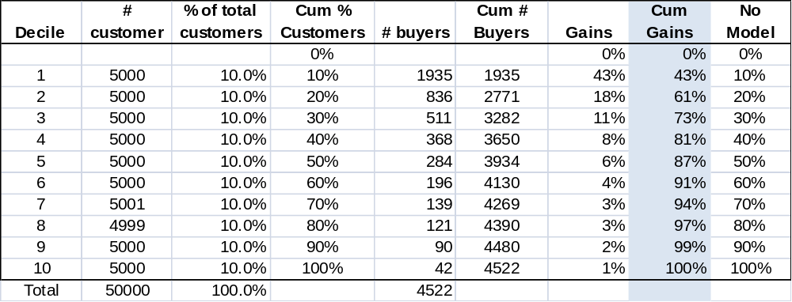
Gains Table

Slide 21
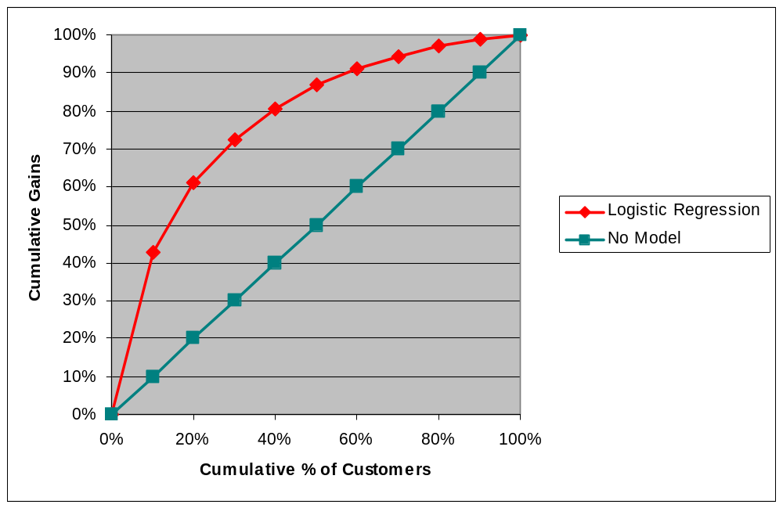
Cumulative Gains Graph (‘banana’ chart)

Slide 22
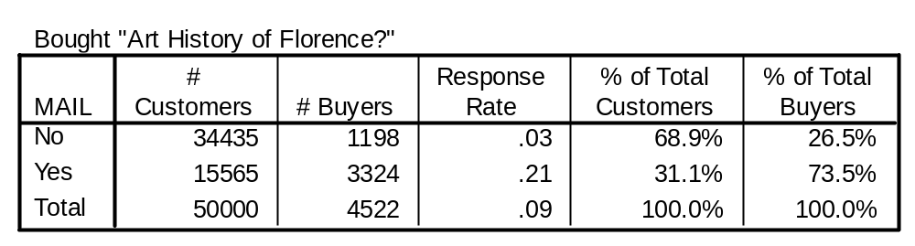
Profitability Analysis:
(Target if response rate >.083)
Target
Gross profit $= 3324($6) – 15565 ($0.5) = $19,944 - $7782.50 = $12,161.50
Gross profit % = $12,161.50 / $59,832 = .2030 = 20.3%
Return on marketing expenditures: $12,161.50/$7782.50 = 1.56, or 156%

Slide 23
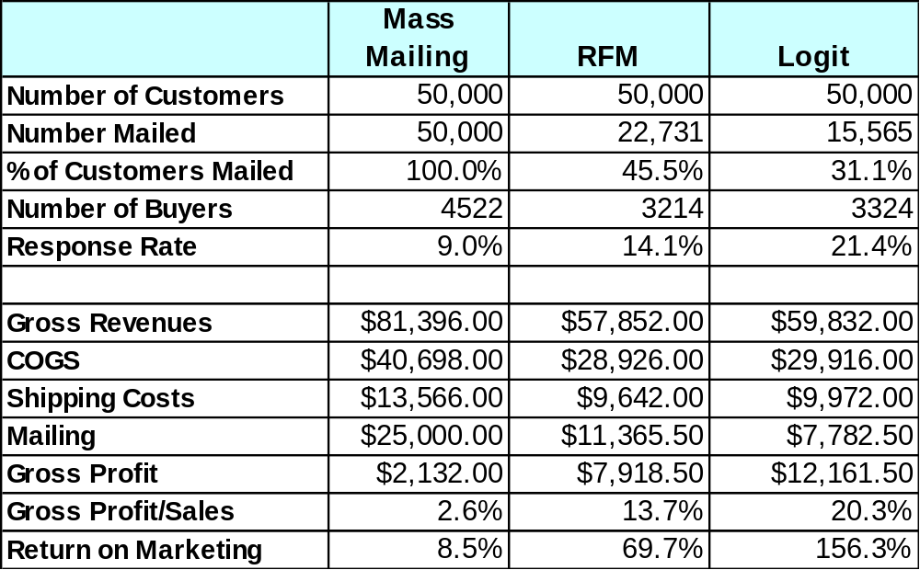
BB Profitability Analysis

Slide 24
For Next Class
Topic:
  Designing and Managing a Loyalty Program Effectively
Reading:
  The Mismanagement of Customer Loyalty
Assignment:
  None

